Slide 1
AACTE Ohio State Chapter
October 12, 2023

Slide 2
Weadé James, Ph.D.
Vice President, Organizational Advancement

Slide 3
What are you hoping to gain from today’s session?
Go to menti.com
Enter the code 2369 4272

Slide 4
How to Effect Change through Advocacy

Slide 5
Why does your Advocacy matter?
To solve specific problems impacting educators and the field through public policy and programs.
To inform or enhance policy priorities of national organizations.
To strengthen and empower institutions, organizations and coalitions to have a greater impact on public policies.

Slide 6
5 Factors that Contribute to a Successful Advocacy Initiative
Identify
Identify Cause
Build
Build or join a Coalition
Develop
Develop a Persuasive Message
Communicate
Communicate Effectively
Organize
Organize a Legislative Visit

Slide 7
1. Identify Cause
What issue is of most importance to you and your profession?
Why should your community, local decision-makers and legislators care about this issue?

Slide 8
What is the biggest issue facing educator preparation in your state?

Slide 9
2. Build a Coalition
Advocacy is more impactful when conducted in a group.
Join or create a coalition to promote grassroots support.
If building a coalition, establish clear goals, guidelines and member responsibilities. Understand that some coalitions have more resources than others, therefore a greater level of involvement may be required.
Coalitions may be statewide or more localized.
EX: Ohio has county and community-specific Anti-Trafficking Coalitions.

Slide 10
2. Build a Coalition cont.
Identify key influencers and decision-makers. Are there individuals in their networks that should join your coalition?
Influencers may include the governors, state senators and legislators, members of the school board and commissions
Identify and tap into existing relationships.
Develop and cultivate new relationships. Consider influencers from different sectors.
Coalition activities may include research and analyses, conducting meetings with policymakers, developing and obtaining support for sign-on letters, and hosting public events like briefings.

Slide 11
3. Develop a Persuasive Message
There’s power in a personal story. Include constituent stories – including experiences of educators, students and families.
Connect your cause with issues that impact the larger community.
How does teacher shortage impact the current and future workforce, the economy and community planning?
Back it up with facts.
Prepare messaging for alternative viewpoints.
Identify cases and examples of success that are local or national.

Slide 12
4. Communicate Effectively
Amplify the volume. Include constituents in your communication. Invite alumni or current candidates from your program to meetings and public events.
Have a clear ask.
Develop alternative policy solutions.
Communicate frequently. Consider participating in school board hearings, legislative breakfast meetings, briefings, and other public events.

Slide 13
4. Communicate Effectively
Leverage social media in your advocacy efforts
Actively work with state or local media to keep issues at the forefront of the public agenda (Op-eds, news stories and press releases).

Slide 14
5. Organize a Visit with State Legislator
Familiarize with the legislative process and calendar.
Identify your “sponsors” or supporters and establish a relationship with them.
If your goal is to introduce a legislation, you will need a legislator to sponsor the bill or take actions to file and advocate for a bill.
Prepare checklists (BEFORE and AFTER)
Develop Talking Points

Slide 15
5. Organize a Visit with State Legislator
Before Your Visit
After Your Visit
Review legislator’s bio, issues they support, bills they’ve introduced and voting record
Prepare brief talking points for coalition participants
Get to know the gatekeepers – Scheduler, Policy Advisors, Legislative Assistants
Understand how the decision-making space functions
Develop clear ASK
Prepare packet of materials to leave behind
Identify closing request and assistance
Send Thank You Note
Share resources
Follow-through on requested assistance
Engage via social media
Add contacts to listserv and vice versa
Schedule a follow-up in the near future (around 3 months)

Slide 16
5. Organize a Visit with State Legislator
Advocacy is cumulative. Plan to host multiple visits during the legislative session.
Host a briefing.
Attend and/or testify at an informational hearing.
Legislative Breakfast
Floor votes

Slide 17
In closing…
Build a coalition of credible actors.
Weigh the opportunities and threats to advocacy given the political climate regionally and nationally.

Slide 18
Upcoming AACTE Events & Resources

Slide 19
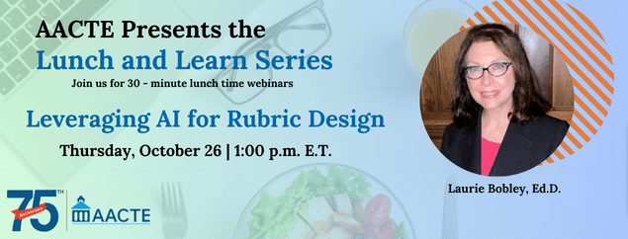
Webinars

Slide 20
SLI

Slide 21
Registered Apprenticeships
https://www.thepathwaysalliance.org/reports

Slide 22
Q&A | Contact Us
Weadé James, Ph.D.
Vice President, Organizational Advancement
wjames@aacte.org
Jacqueline King, Ph.D.
Senior Consultant
jking@aacte.org

